Slide 1

Directory Services
www.corvit.com

Slide 2
Introduction to Directory Service
Example of directory services : Have you ever lookup of phone number on phone directory or on a store products directory .
Directory services are useful for organizing data and making it searchable for an organization.
Instead of managing user accounts and computer information locally on every machine all that information can be store on a directory server for easy access and management .
www.corvit.com

Slide 3
Quality Directory Server
The quality directory server should support replication.
The stored directory data can be copied and distributed across a number of physical distributed servers , but still appear as one unified datastore for querying and administrating.
This increases the speed and decreases disruption and latency .
Data stored on directory server should be accessible to machines with different operating systems.
www.corvit.com

Slide 4
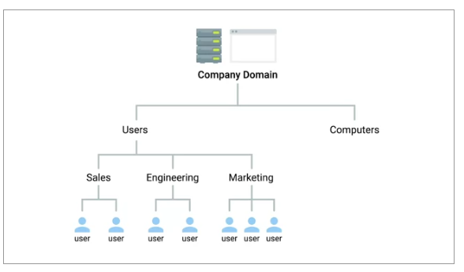
Hierarchal Structure Of Directory Server
Hierarchal structure of directory server contain container or organizational unit and objects.
www.corvit.com

Slide 5
Protocols and software for active directory services
Directory Access Protocol (DAP)
Directory System Protocol (DSP)
Directory Information Shadowing Protocol (DISP)
Directory Operational Bindings Management Protocol (DOP)
Alternative to DAP there is Lightweight Directory Access Protocol (LDAP) that is used by Microsoft Active Directory software.
OpenLDAP is another software that is used as open-source implementation of LDAP.
www.corvit.com

Slide 6
Centralization Management
What is centralization management ?
Centralized management is the organizational structure where a small handful of individuals make most of the decisions in a company. As a company with centralized management grows, they add new levels of mid and lower level managers, each of whom answers to a superior, with very strictly defined roles in the company
Centralization refers to that organizational structure where decision-making power is confined to the top management, and the subordinates need to follow the instructions of their seniors. Centralization of authority is essential for the small-scale organizations which lack resources and finance.
Example 1 :
A person running a departmental store appoints a manager, a cleaning staff, a salesperson and a helper. The owner delegates the work among the staff according to their skills and positions.
www.corvit.com

Slide 7
Example 2
A small family diner owned by a married couple probably uses centralized management.
What are features of centralized management?
Top management.
Authority to make a decision is in the hand of top management only.
Information flows from the upper level to lower levels.
Longer time to make decisions.
Centralization is suitable for a small organization.
Inflexible in nature.
Advantages of centralization:
Centralized control of a business can have several downsides, including stifled creativity, limited communication, inflexible decision-making, and the danger of losing a key decision-maker.
www.corvit.com

Slide 8
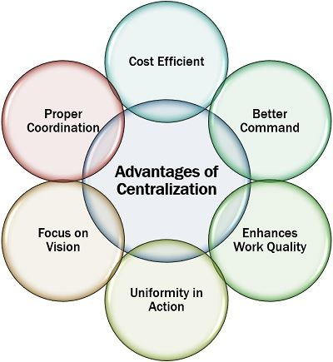
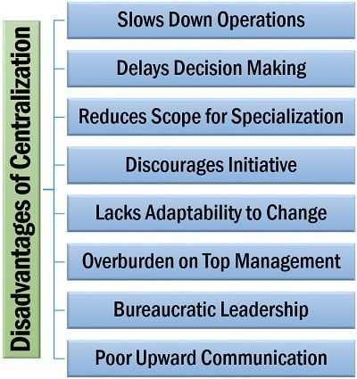
Advantages And Disadvantages
What are disadvantages of centralization?
Centralized control of a business can have several downsides, including stifled creativity, limited communication, inflexible decision-making, and the danger of losing a key decision-maker.
www.corvit.com

Slide 9
Configuration Manager
what is Configuration Manager ?
Configuration Manager to help you with the following systems management activities:
Increase IT productivity and efficiency by reducing manual tasks and letting you focus on high-value projects.
Maximize hardware and software investments.
Empower user productivity by providing the right software at the right time.
www.corvit.com

Slide 10
RBAC ( Role Based Access Control )
Role-based access control :
Role-based access control (RBAC) is a policy-neutral access-control mechanism defined around roles and privileges. The components of RBAC such as role-permissions, user-role and role-role relationships make it simple to perform user assignments.
Three primary rules are defined for RBAC :
Role assignment: A subject can exercise a permission only if the subject has selected or been assigned a role.
Role authorization: A subject's active role must be authorized for the subject. With rule 1 above, this rule ensures that users can take on only roles for which they are authorized.
Permission authorization: A subject can exercise a permission only if the permission is authorized for the subject's active role. With rules 1 and 2, this rule ensures that users can exercise only permissions for which they are authorized.
www.corvit.com

Slide 11
LDAP
Lightweight Directory Access Protocol
www.corvit.com

Slide 12
WHAT IS LDAP?
It is used to access information in directory services like over a network.
LDAP conveys directory content as a set of records, one record for each object (or entry). It also represents update requests, such as Add, Modify, Delete, and Rename, as a set of records, one record for each update request.
Directory services
Two of most popular directory services are used in LDAP that are
Active directory
Open LDAP
www.corvit.com

Slide 13
LDAP Data Interchange Format
The LDAP Data Interchange Format (LDIF) is a standard plain text data interchange format for representing Lightweight Directory Access Protocol (LDAP) directory content and update requests.
Example
den: CN=john Smithson=legal, DC=example, DC=com
Look at an other example
den: can=The Postmaster, dc=example, dc=com object Class: organizational Role can: The Postmaster
This is an example of an LDIF record that modifies multiple single-valued attributes for two different directory entries (this format is used by Microsoft's LDIFDE tool):
www.corvit.com

Slide 14
LDAP Authentication
The LDAP is one of the core authentication protocols that was developed for directory services. LDAP historically has been used as a database of information, primarily storing information like:
Users
Attributes about those users
Group membership privileges
… and more
www.corvit.com

Slide 15
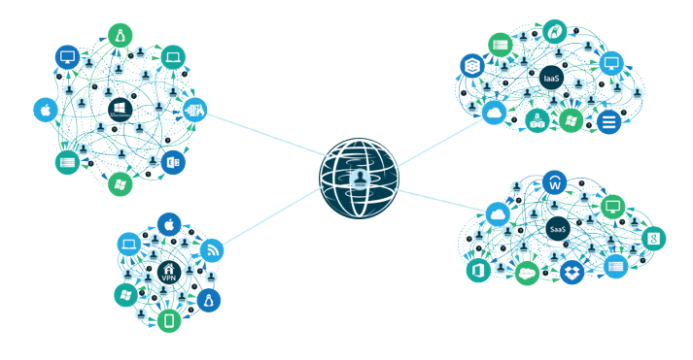
Basic LDAP Authentication and Common Challenges
LDAP authentication follows the client/server model. In this scenario, the client is generally an LDAP-ready system or application that is requesting information from an associated LDAP database and the server is, of course, the LDAP server.
The server side of LDAP is a database that has a flexible schema. In other words, not only can LDAP store username and password information, but it can also store a variety of attributes including address, telephone number, group associations, and more.
www.corvit.com

Slide 16
AD Active Directory
www.corvit.com

Slide 17
What is Active Directory?
Active Directory (AD) is a database and set of services that connect users with the network resources they need to get their work done. The database contains critical information about your environment, including what users and computers there are and who's allowed to do what
Why it use ?
Active Directory uses a structured data store as the basis for a logical, hierarchical organization of directory information . Active Directory was used only for centralized domain management.
www.corvit.com

Slide 18
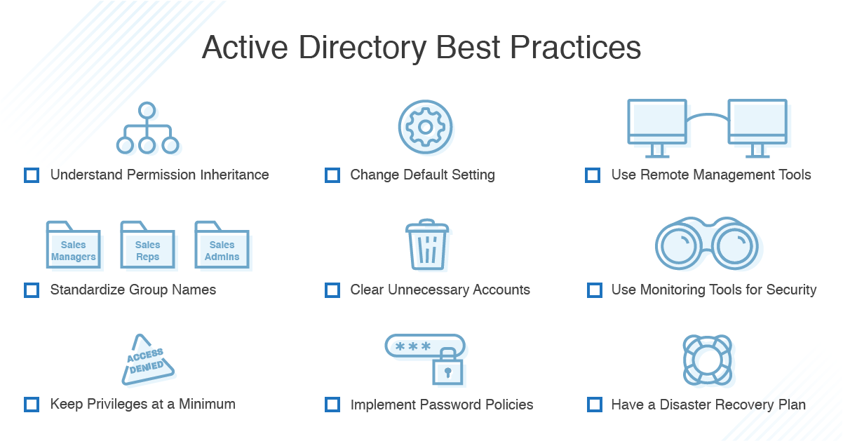
Active Directory Best Practices
www.corvit.com

Slide 19
What are the 5 roles of Active Directory?
Schema master.
Domain naming master.
RID master.
PDC emulator.
Infrastructure master.
What is Active Directory step by step?
Create a new user account.
From the Start menu, go to Programs > Administration Tools.
Choose “Active Directory Users and Computers.”
Enter a user name and password for the new user, and create the user.
Verify that the Kerberos ticket is returned by the Kerberos Authentication Server properly.
www.corvit.com

Slide 20
What Is Open LDAP
Directory Service like Active Directory
Open Source
Supports Windows, Linux and MacOS
Operates very Similar to Active Directory
Uses LDAP notation or LDAP data interchange format for authentication and management.
www.corvit.com

Slide 21
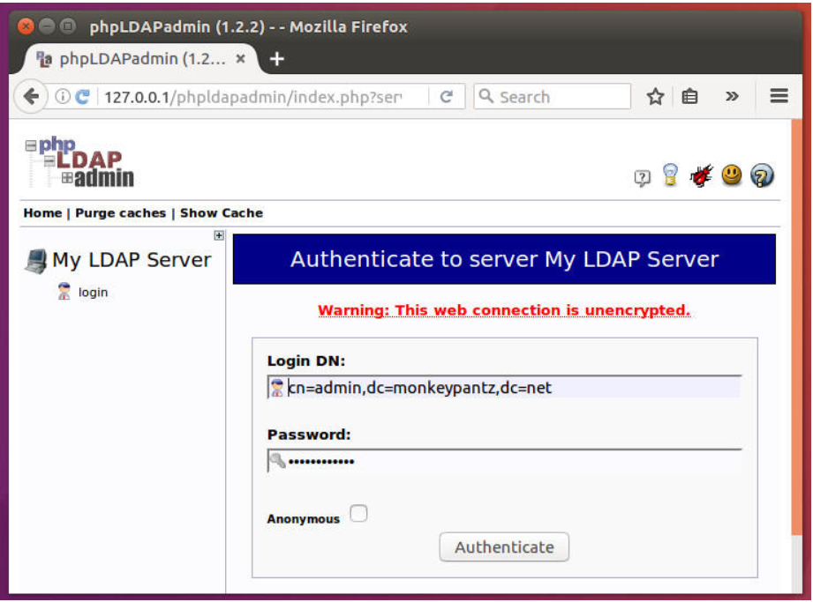
Ways To Access Open LDAP
Command Line Interface
phpLDAPadmin
www.corvit.com
Notes:
https://www.digitalocean.com/community/tutorials/how-to-install-and-configure-openldap-and-phpldapadmin-on-ubuntu-16-04
https://www.openldap.org/doc/admin24/slapdconf2.html

Slide 22
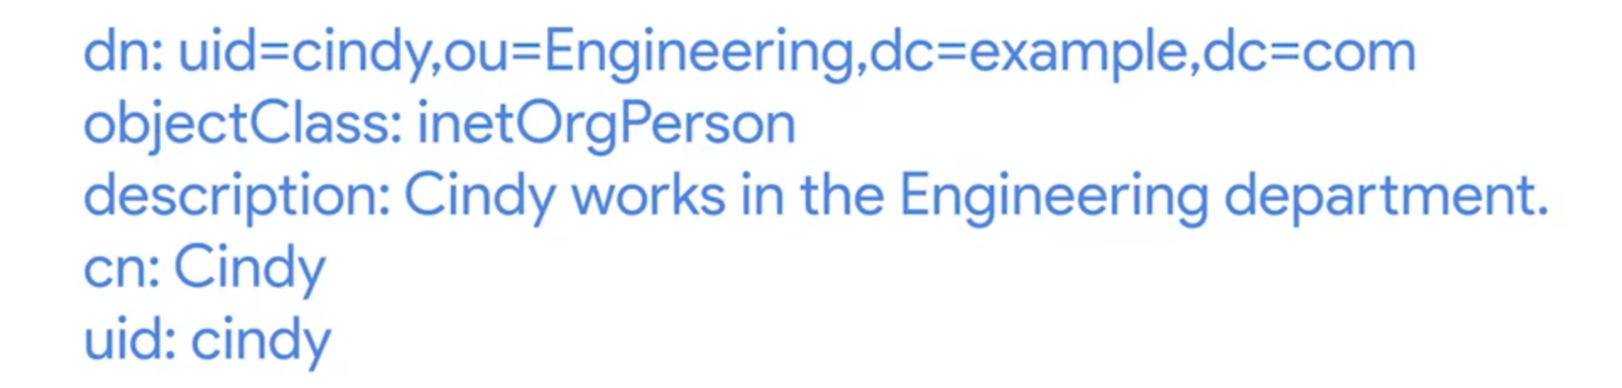
Managing Open LDAP
phpLDAPadmin
LDIF Format
www.corvit.com

Slide 23
Managing Open LDAP (Cont.)
Ldapadd: this takes the input of an LDIF file, and adds the context of the files.
Ldapmodify: this modifies an existing object.
Ldapdelete: this will remove the object that the LDIF file refers to.
Ldapsearch: this will search for entries in your directory database.
www.corvit.com

Slide 24
Out-Comings
Pros:
Cost
OS-Agnosticism
Flexibility
Cons:
Manual-Intensive Configuration Management
More Limited Toolset than Competitors
Limited Scope
Open LDAP:
Single Protocol (LDAP)
Less Functionality through GUI
Works same on different Operating Systems.
Open LDAP incurs hidden costs in its maintenance and management.
Active Directory:
Multi-Protocol (uses LDAP and many others like Kerberos for authentication)
Rich GUI provides more functionality and flexibility
AD’s features set can be limiting to Windows only
AD comes at a per-user cost
www.corvit.com

